Slide 1
CKSDC 2023 end of season meeting agenda
2023 CKSDC championship recap
What went well
What needs improving
Treasurer’s report
2024 parking fee structure
Dates for 2024 CKSDC Championships
Dates for Board of Directors Meeting
Links to:
Photo sharing site
Livestream in the cloud
Roll call
Minutes from last meeting

Slide 2
Treasurer report
Cash flow update
Missing Accounts Receivables
Discussion

Slide 3
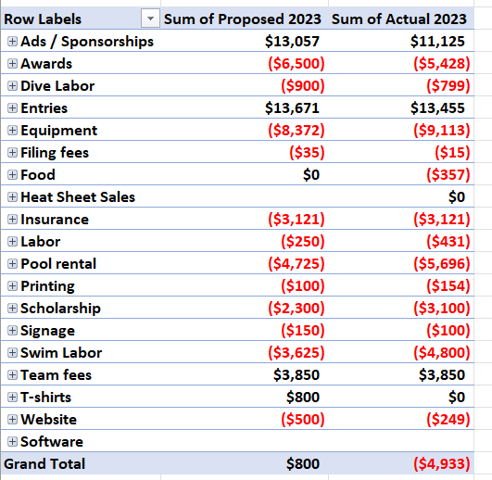
Budget update
~$4,000 over budget, but we came into the year with ~$11,000 surplus
Spent ~$45,000, generated ~$41,000
Over budget on:
Labor
More clerk of course and livestream workers needed than expected
Social media
Senior scholarships – 31
Tent revenue / team reimbursements (under equipment)
Pool rental – added restroom attendant
Under budget on:
Awards
Full details can be accessed here - 2023 Budget.xlsx

Slide 4
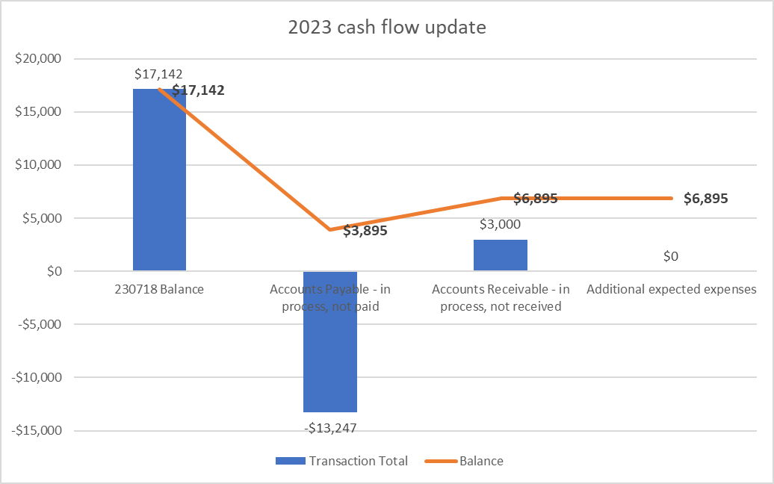
Cash Flow Update
Revenue
Missing Accounts Receivable
Athlete fees / tent rental:
Arlington - $1,836
Ads / sponsors:
Swimville - $789
Sporfie - $211
T-shirts - ??
Mt. Sterling - $400
Should have a ~$7,000 surplus going into 2024

Slide 5
Survey
27 respondents
Overall positive ratings
Lots of specific comments

Slide 6
What went well
Hiring Morgan Neuer from Signature Club to handle social media
Instagram account is barely two weeks old and touched over 3,500 accounts in the last week
Livestream
Had over 800 viewers
These should help ad and sponsorship sales next year, knowing what a broad reach that our conference has
Thanks to USA observed status, at least 4 swimmers made state cuts at the meet
Clerk of Course organization and hiring workers

Slide 7
What needs improving
Clerk of Course – day 1 kids got caught up in the new cattle chute – need to let them flow through better
Was addressed quickly after getting coach feedback
Forgot to cover tent stakes to prevent accidents (Russ/Goff Tents)
Need bigger tents in clerk of course to provide more shade to swimmers and fit more chairs under the tent (Greg/Russ/Goff Tents)
Address parking backup on Monday / explore new parking fee structure
Reminders to audience about hot mics on the livestream
Regular season scheduling, especially with duplicate opponents on tri-meets
Do we have to stick with A and B division scheduling?
General succession planning – we need to be looking out for future leaders in the organization with young swimmers and divers

Slide 8
What needs improving
Need fundraising lead
Not a big enough deal made about conference records broken
Sequencing of awards and races – some were happening at the same time on Wednesday
Mixed feedback on restrooms / value of extra attendant
Tri-meet repeat opponents, scheduling….
Who would be a good 12th team?
Consistent sound system on both dive boards
Add a photo release to hold harmless agreement / requirements of each team / swimmer during registration
Formally eliminate finish line judges when semi-automated timing systems are used; establish a coach dispute / challenge process
Update Meet Mobile more frequently during championships

Slide 9
Other crazy ideas (some were brought up in previous years)
League-wide Swimtopia license for volunteer and other admin management - $3 per swimmer
Add 100 IM
Consider investing in:
Scoreboard
Dive scoring equipment
On demand press shirts
Fundraising intern

Slide 10
Parking
Spindletop Hall keeps parking and made $13,000 this year.
Good weather contributed – may never be better conditions
Pool rental is increasing to $5,000 next year (from $4,750)
Lynne negotiated a set fee of $11,500 next year that we’d have to spread across 11 teams and 1,500 athletes. Around $8 per athlete would be added to team fees
Discussion points
____________________________
____________________________

Slide 11
Need to set dates for
Board of Directors meeting
July 7-10
July 14-17 – SIG, ARL, IHCC, HART, LCC, WCC, MTS

Slide 12
Links
Photos – upload all photos and videos to here for publishing to social media
Livestream – share with working parents, out of town family members and friends
CKSDC structure

