Slide 1
CKSDC treasurer report – July 6, 2023
Cash flow update
Missing Accounts Receivables
Fundraising update
Risks and opportunities
Other items
Clerk of Course
Livestream
Photo sharing

Slide 2
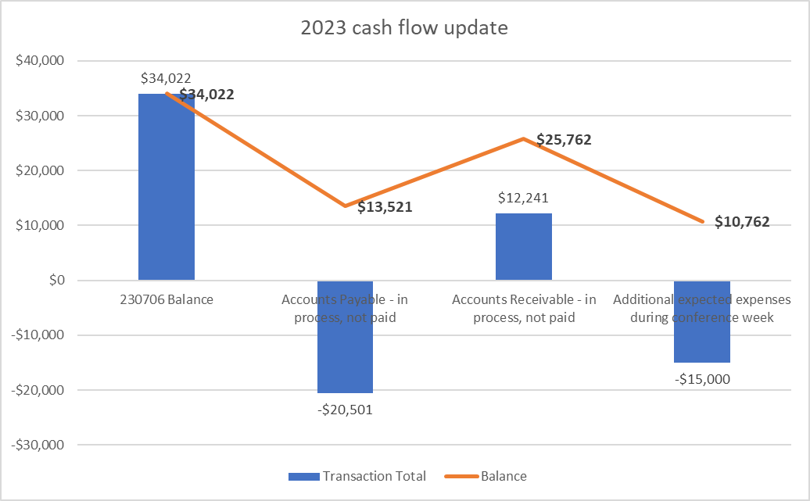
Cash Flow Update

Slide 3
Missing A/R
Revenue
Missing Accounts Receivable
Athlete fees:
Arlington
Ads / sponsors:
Jack Rudy - $200
Brad Turner - $200

Slide 4
Fundraising Update

Slide 5
Other reminders
Clerk of Course – get all workers and coaches to join the GroupMe chat
Prep zoom meeting at 6:00 PM Sunday evening
Photos – upload all photos and videos to here for publishing to social media
Livestream – share with working parents, out of town family members and friends

