Slide 1
CKSDC treasurer report – May 23, 2023
Cash flow update
2023 budget
Risks and opportunities

Slide 2
Cash flow update
~$15,000
Revenue
7 teams have paid $350 team fees
Missing: Arlington, Winchester, Mt. Sterling, Greenbrier
$5000 sponsorship (Palumbo Lumber)
Expenses
Insurance
Web site / administrative fees

Slide 3
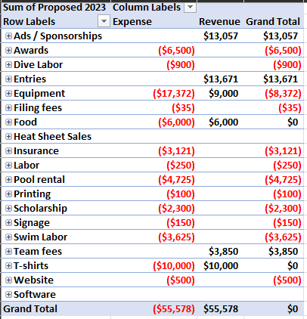
2023 Budget

Slide 4
2023 Budget – risks and opportunities
Risks
Inflation
Restaurants no longer willing to donate food
Can we increase sponsorships?
Can we get enough food sponsorships to cover coach and official meals?
Opportunities
Can use some of excess $10,665 to cover some expenses without raising costs or additional sponsorship money
Looking into livestream options for conference championship

Slide 5
Hold harmless agreement
Required for insurance purposes
Required to be signed / acknowledged by every athlete who participates in a CKSDC meet
Should have been included in each team’s registration process, per the email sent out on 3/19/2023

